Slide 1








ADIDAS SALES ANALYSIS

Slide 2
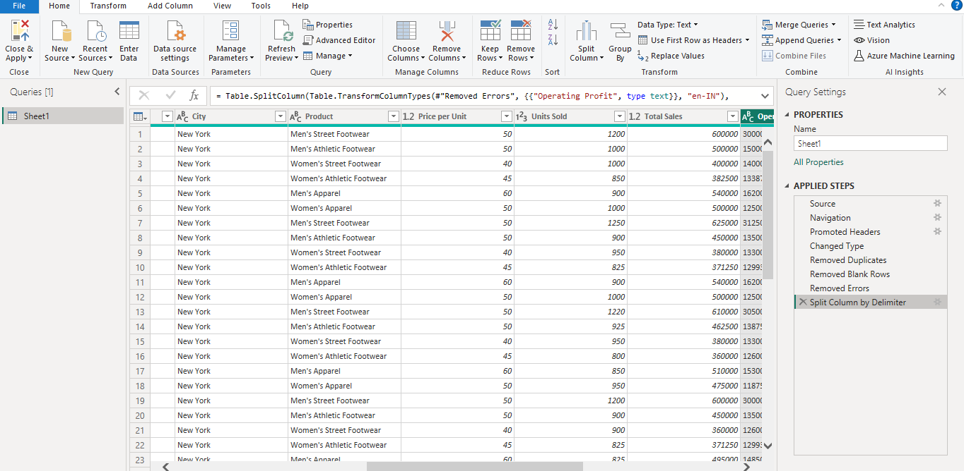
TRANSFORMATION

Slide 3
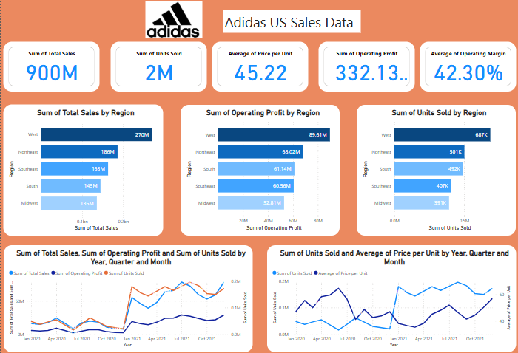
VISUALISATION

Slide 4
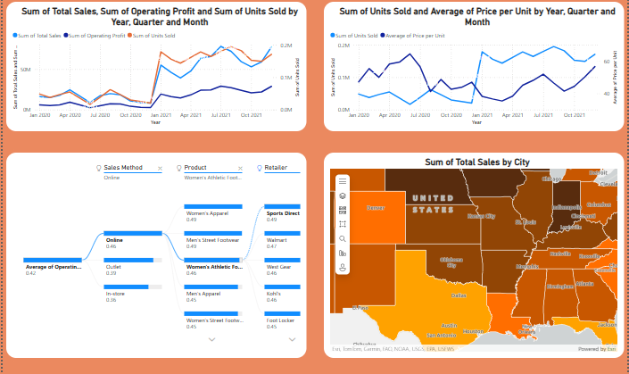
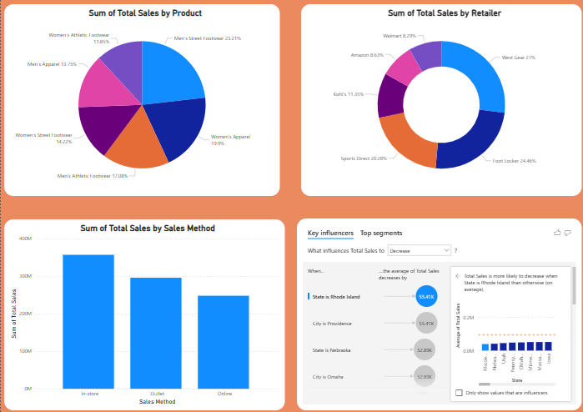
VISUALISATION

Slide 5
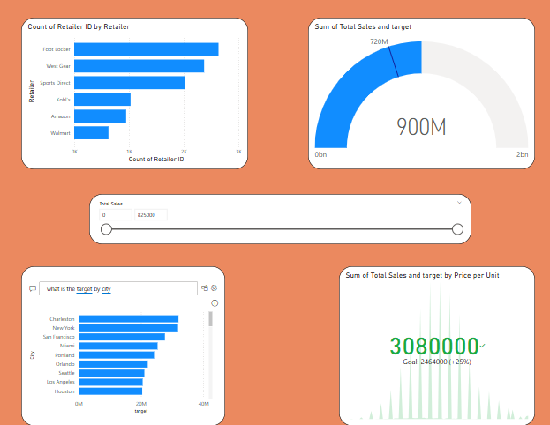
VISUALISATION

Slide 6
CONCLUSION
Key Performance Metrics
Displays Total Sales, Units Sold, Profit, and Operating Margin in KPI cards.
Compares actual sales vs Target Sales using a KPI visual.
Regional & Retailer Insights
Sales by Region (West, Northeast, South, etc.) with bar charts.
Retailer-wise sales contribution using a bar chart.
Trend Analysis & Growth Tracking
Line Chart tracks Year-over-Year Sales Growth using DAX.
Sales and Operating Profit trend over time.
Product & Sales Method Breakdown
Top-Selling Products using bar charts and tooltips.
Sales method comparison (Online, Outlet, In-Store) via pie chart.
Interactive & AI-Powered Insights
Decomposition Tree to drill into sales by method, product, and retailer.
Key Influencers Visual to highlight factors driving sales.

Slide 7
THANK YOU

